Slide 1
Crime & Safety
Group 14
Kavya Gundla
Sai Priya Nallamala
Anirudh Muppidi
Sai Krishna Kakollu
Sashi Kiran Maddineni
Mushfiq Hussain

Slide 2

Introduction
Use case : Crime and Safety.
Denton might seem like a peaceful heaven but there's more to the story. We used special tools to make sense of crime reports and paint a picture of what's really happening. It's not just about the numbers on the paper but a map of red dots, each one telling a real- life story. This map reveals hidden patterns such as theft from buildings, shoplifting to simple assault. It's also not about the blame; it's about understanding. The insights we found from the tasks can help officers keep us safe and citizens be aware. This project is about using data to make Denton to a safer place, one step at a time.

Slide 3
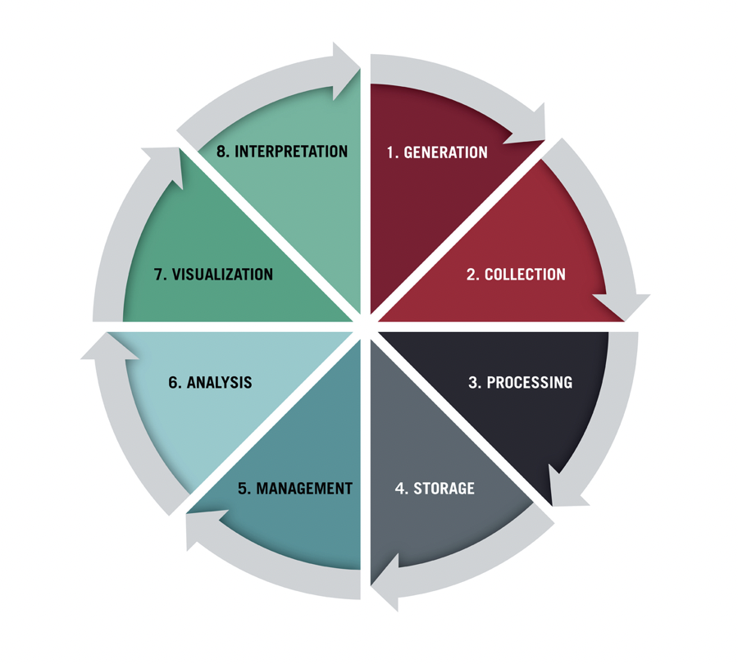
Data Life Cycle
According to (Stobierski, T. ,2021, February 2), data lifecycle consists of 8 steps:
Data Generation
Data Collection
Data Processing
Data Storage
Data Management
Data Analysis
Data Visualization
Data Interpretation

Slide 4
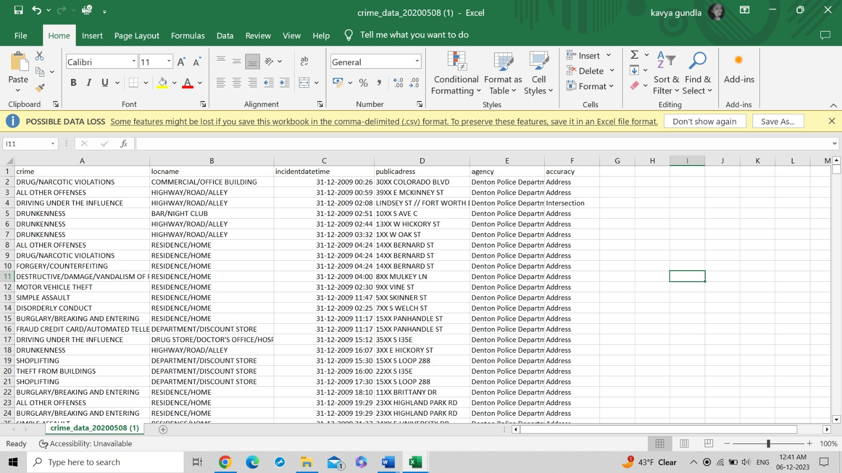
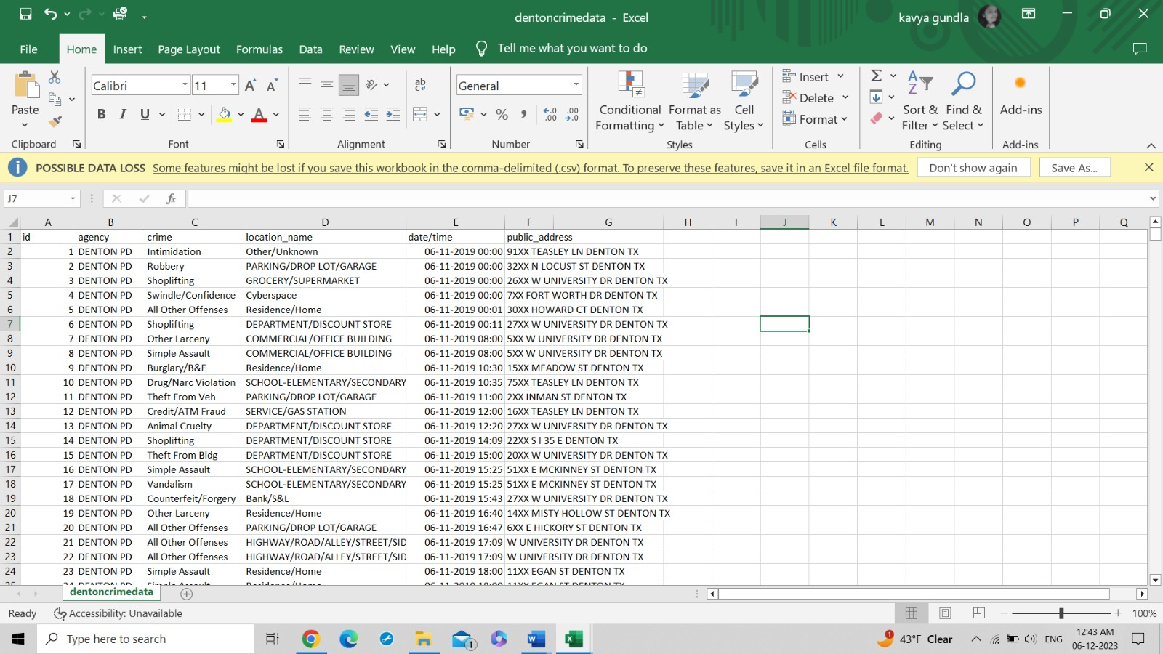
Data Collection
Static dataset
Streaming dataset

Slide 5
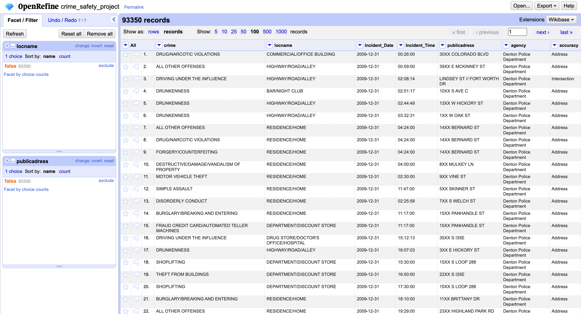
Data Processing
Using Open Refine, We performed data cleaning on the static and streaming data source datasets and removed null values for better analysis.
'

Slide 6
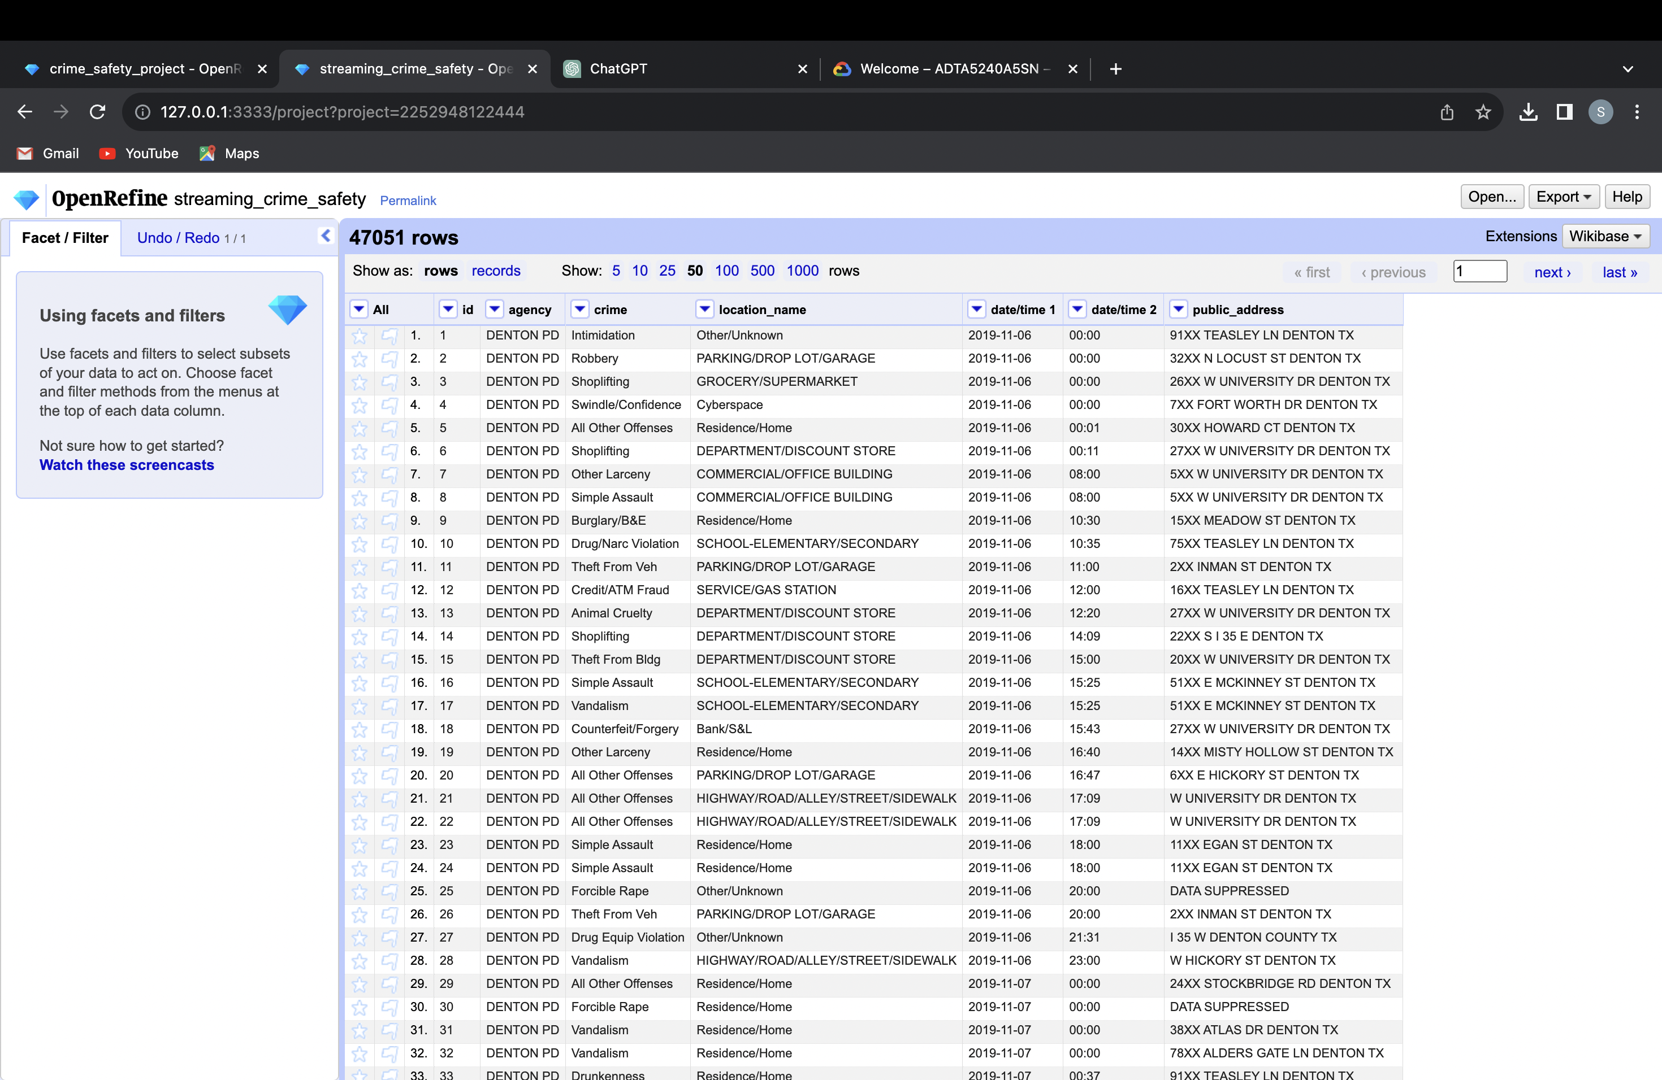
Data Processing
Additionally, as the incidentdatetime1 column contains date and time of the crime occurred as one string. We split this column into two columns one incident_date and incident_ time for better analysis.
'

Slide 7
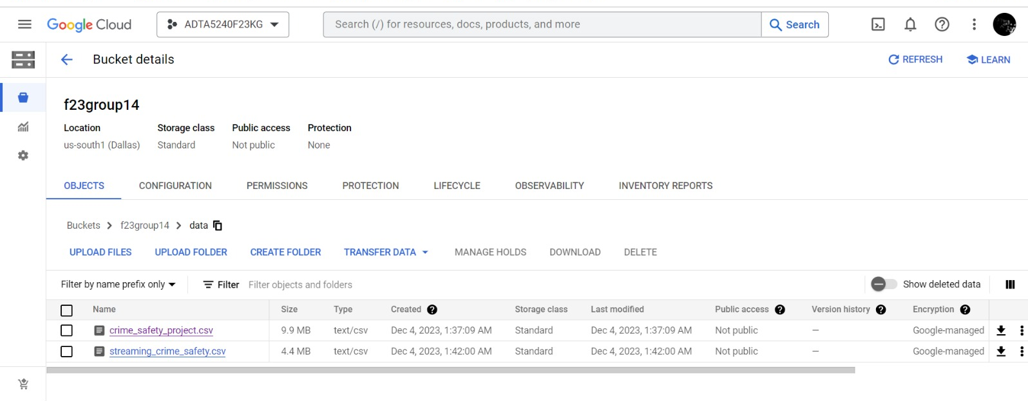
Data Storage
We stored our refined datasets into Google Cloud Console using buckets. At first, we created a bucket especially for this project, names as 'f23group4' and then uploaded the processed datasets.
Then, these datasets are moved into the 'data' folder that we have created.
'

Slide 8
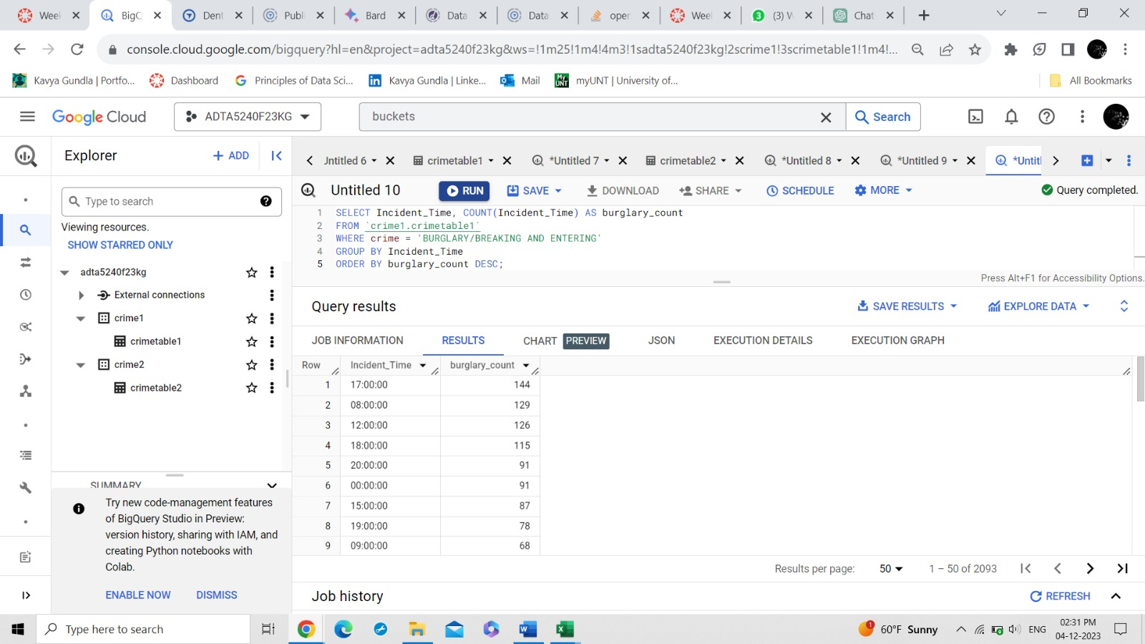
Data Management
Using BigQuery studio offered by Google Cloud Console, we performed some queries on both the datasets.
The insights we achieved from the query shown in the image includes that most of 'burglary or breaking and entering' crimes occurred at 5pm in the evening and the next leading time period is 8AM in the morning for the 2008 - 2019 time period.
'

Slide 9
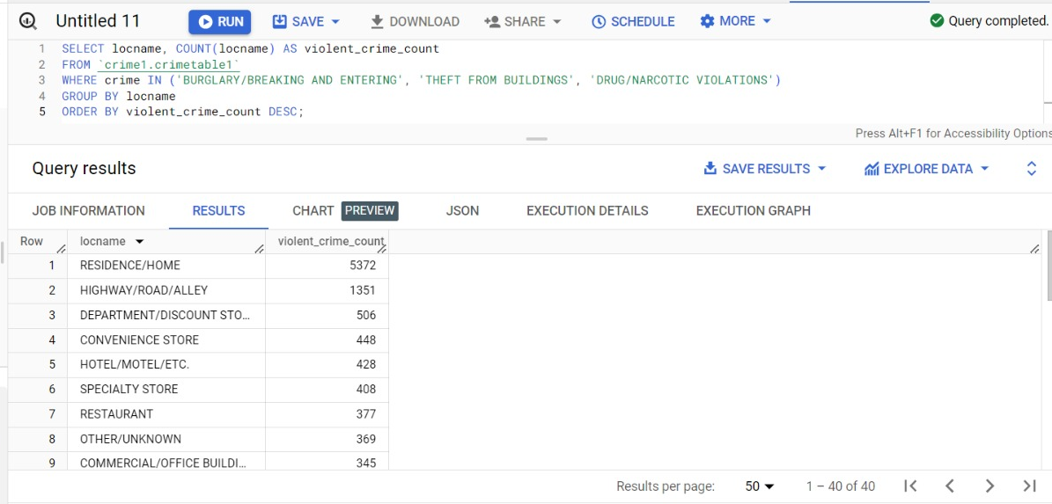
Data Management
Query shown in the image tells that most of the 'burglary/breaking and entering', 'theft from buildings' and 'drug/narcotic violations' occurred at residence/home , the report tells us that 5372 crimes has occurred in 2008-2019 time period.
'

Slide 10
Insights
Using the BigQuery and hive & spark, we executed different queries and achieved many insights from both the datasets.
More than 9065 simple assault crimes were occurred in 2008-2019 time period.
It was also observed that from 2019 to the current date, simple assault cases are 5729 which is almost more than half of the previous decade, so, it seems like there is increase in the simple assault crimes.
16893 crimes were occurred in between 2019 to the current data at Residence/Home and then 9282 crimes were at the Highway/Road/Alley/Street. But for the static dataset, we found that 44279 crimes were reported from the residence/ home. It can be said that most of the residential neighborhoods in Denton need to be careful.
All these insights we got from the querying can be helpful to data scientist/ analysts to carry out the Data Analysis, Data Visualization and Interpretation phases of the data life cycle for further analysis.

Slide 11
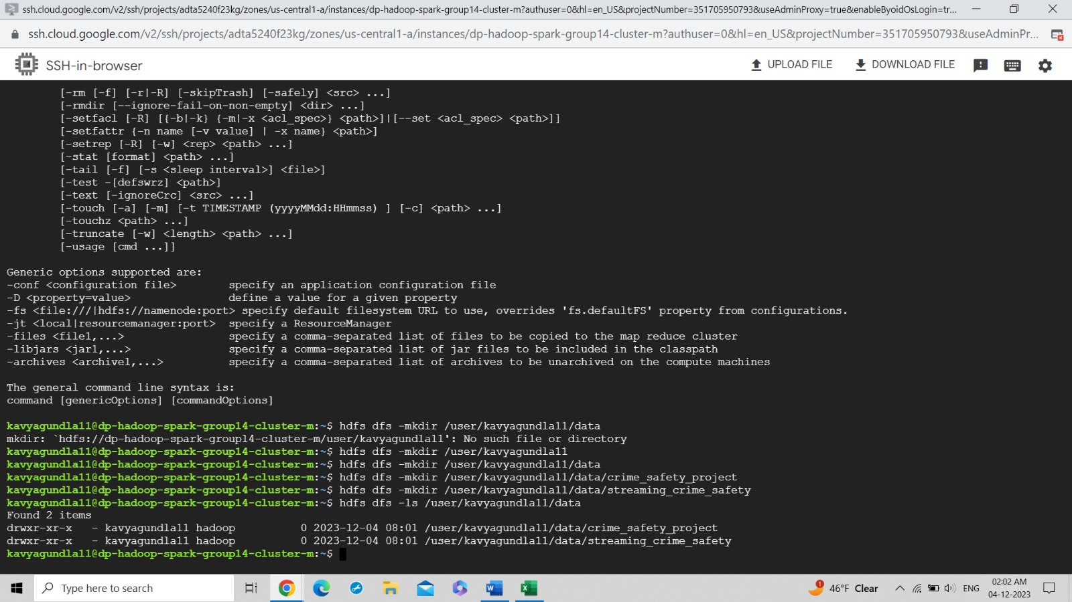
Hadoop - Dataproc
We created a dataproc Hadoop cluster in GCP and by using SSH browser, we copied the datasets that were stored in the GCP buckets to HDFS.
'

Slide 12
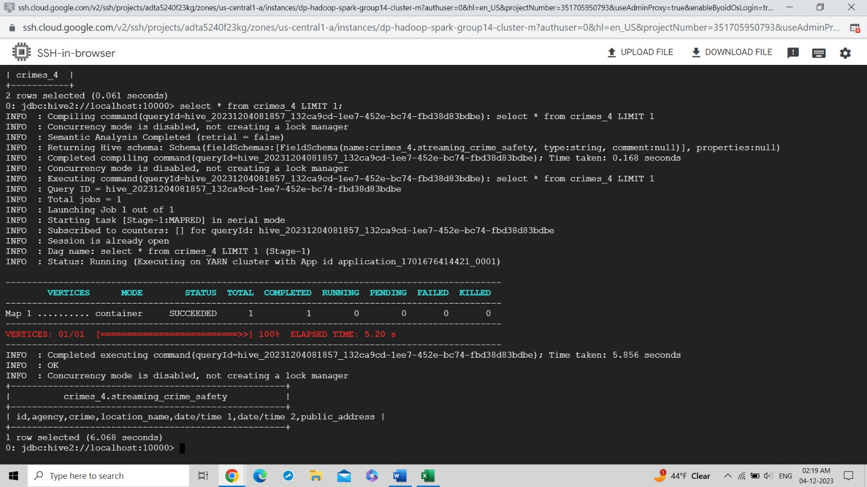
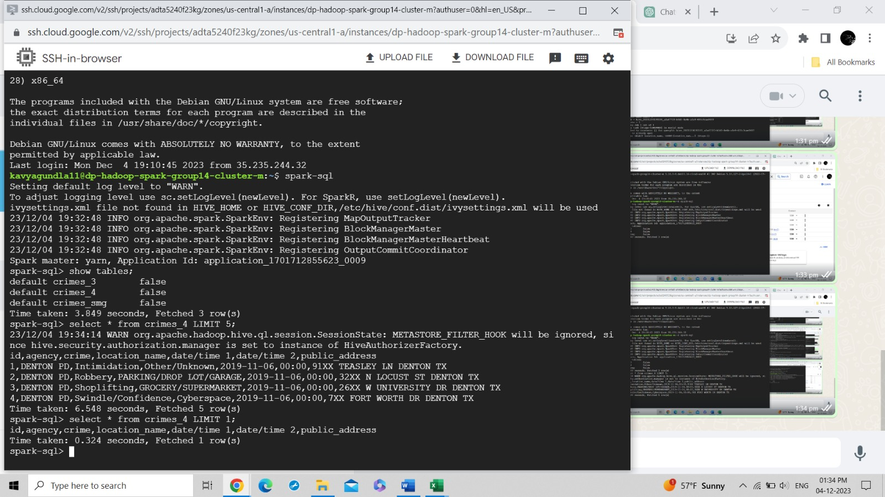
Hive & Spark Comparison
After starting the beeline interface , we executed some Hive commands and a query ' select * from crimes_4 LIMIT 1'. We observed that the time taken by Hive to execute this query is 6.068 s.
'
For first query , Spark took 0.324 seconds to execute and provide results.

Slide 13
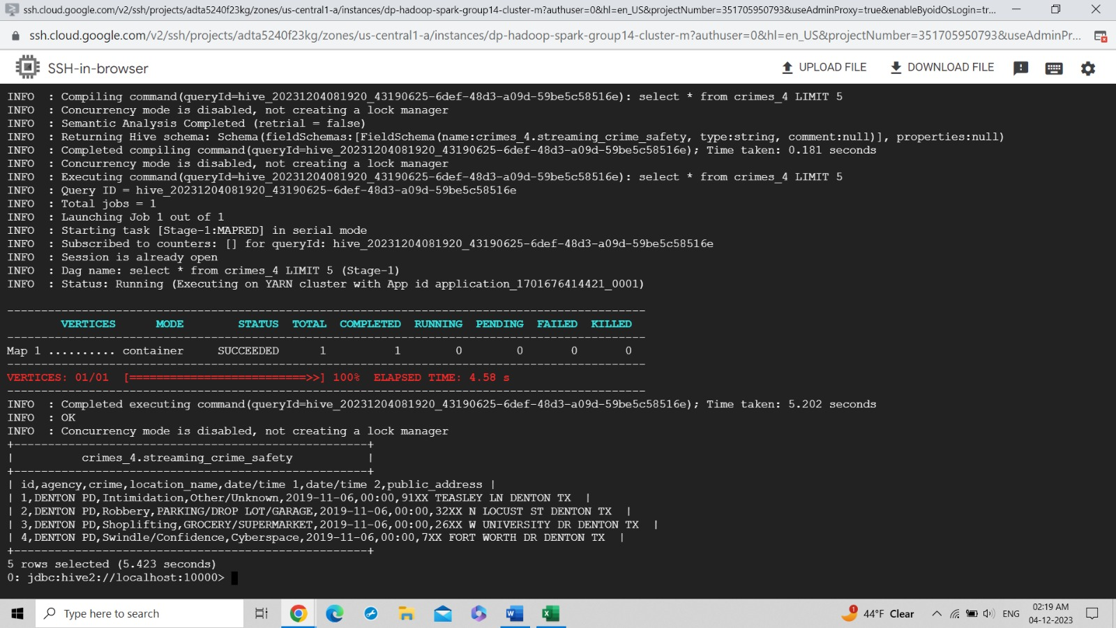
Hive & Spark Comparison
We performed another query ' select * from crimes_4 LIMIT 5 ' and Hive took 5.423s to execute this query and provide the first 4 rows of the dataset.
'
For second query, spark took 6.548 seconds

Slide 14
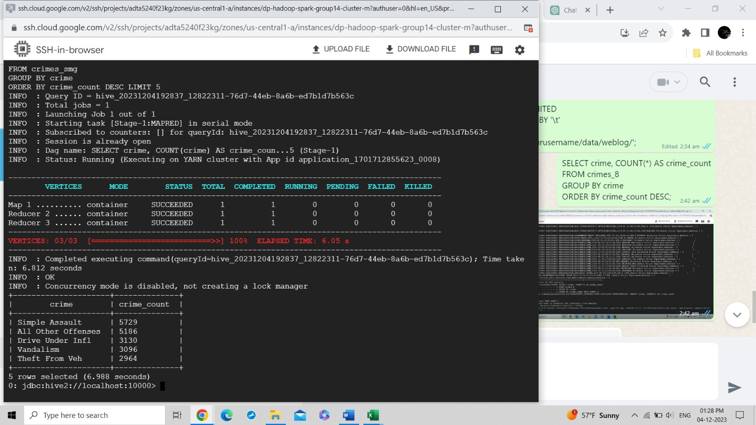
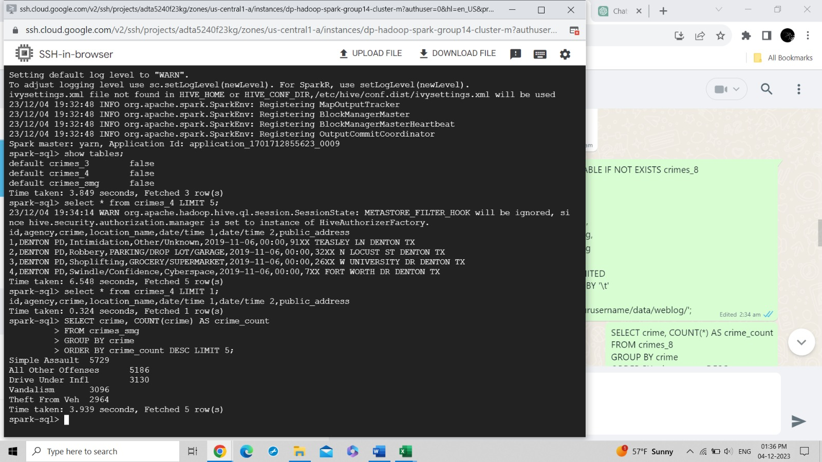
Hive & Spark Comparison
This time, we executed a complex query ' select crime, COUNT(crime) AS crime_count from crimes_smg GROUP BY crime ORDER BY crime_count DESC LIMIT 5; ' and Hive took 6.988 seconds to execute and provide the results.
'
For complex query, Spark took 3.939 seconds

Slide 15
Conclusion
The patterns and insights found from the transformative power of OpenRefine, GCP, Hadoop, Hive , Spark and BigQuery have highlighted the hidden dynamics that shape the city's criminal activity.
The key findings revealed a complex interplay between time, location and type of the crime such as theft from the buildings, burglary or breaking into homes etc.
This project is not just about working on numbers; it is about empowering Denton citizens and officers for a safer future. Additionally, these insights and managed data will be helpful for data scientists and analysts for further analysis.
Datasets from :
Streaming dataset - Denton Crime Data - City of Denton Open Data. https://data.cityofdenton.com/dataset/denton-crime-data
Static dataset - Crime data - City of Denton Open data. https://data.cityofdenton.com/dataset/crime-dataset
'

Slide 16

Thank you
Group 14
Questions?

